Slide 1
Bayesian Classifier

Slide 2
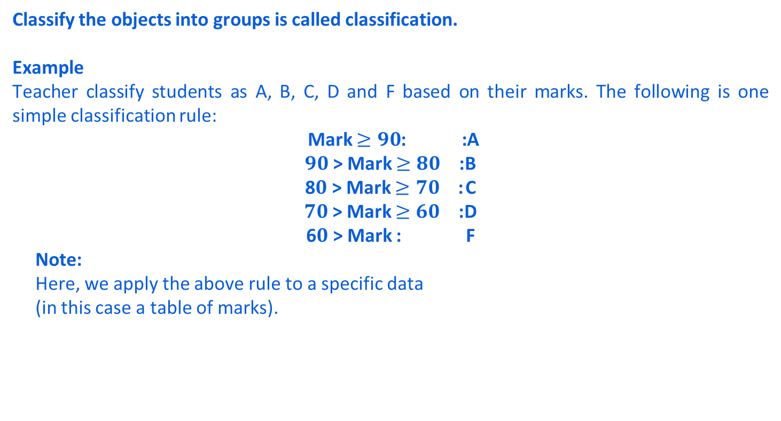
Classify the objects into groups is called classification.
Example
Teacher classify students as A, B, C, D and F based on their marks. The following is one simple classification rule:
Mark $≥90$: :A
$90$> Mark $≥80$ : B
8$0$> Mark $≥70$ : C
$70$> Mark $≥60$ : D
6$0$> Mark : F
Note:
Here, we apply the above rule to a specific data
(in this case a table of marks).

Slide 3
Examples of Classification
Life Science: Predicting tumor cells as benign or malignant
Security: Classifying credit card transactions as legitimate or fraudulent
Prediction: Weather, voting, political dynamics, etc.
Entertainment: Categorizing news stories as finance, weather, entertainment, sports, etc.
Social media: Identifying the current trend and future growth

Slide 4
Classification : Definition
Classification dividing important data into classes. It assigned data objects to one of a number of mutually exhaustive and exclusive categories known as classes.
The term “mutually exhaustive and exclusive” simply means that each object must be assigned to precisely one class
That is, never to more than one and never to no class at all.
Exhaustive :- A collection of events is exhaustive if at least one of them must occur.
A collection of events is non-exhaustive if it is possible for none of them to occur.
Exclusive : Events are mutually exclusive if no two of them can occur simultaneously

Slide 5
Classification Techniques
Classification consists of assigning a class label to a set of unclassified cases.
Supervised Classification
The set of possible classes is known in advance.
Unsupervised Classification
Set of possible classes is not known. After classification we can try to assign a name to that class.
Unsupervised classification is called clustering.

Slide 6
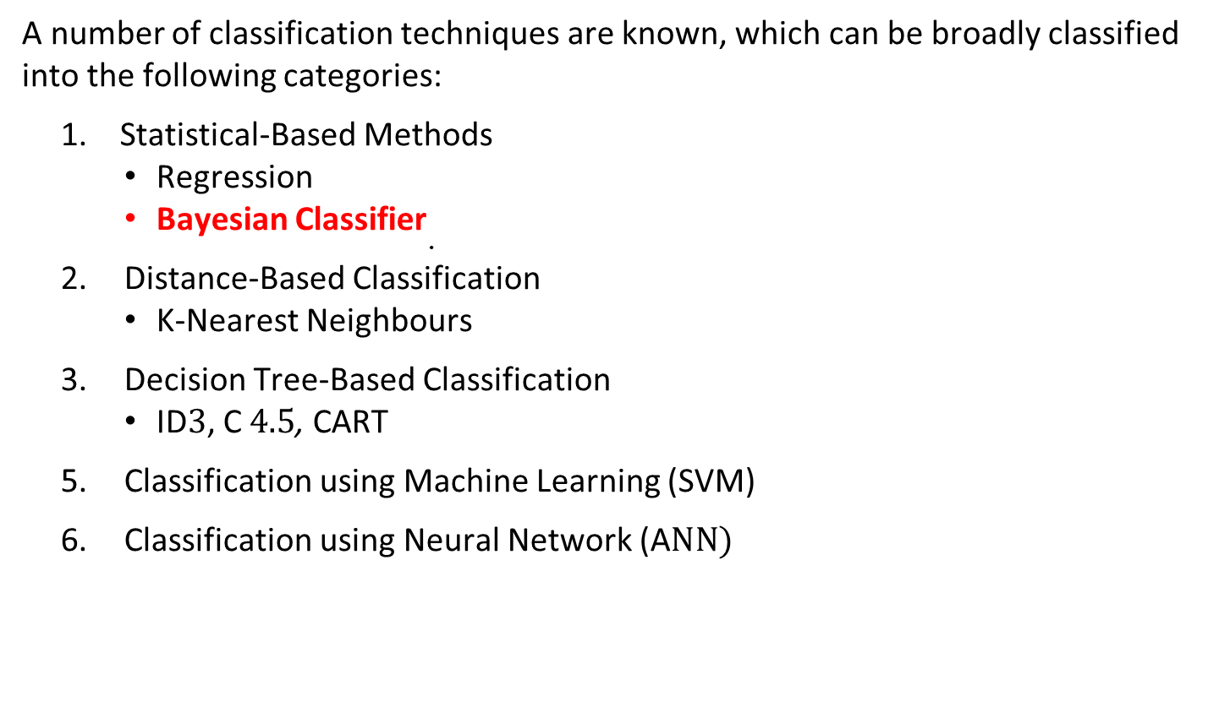
Classification Techniques
A number of classification techniques are known, which can be broadly classified into the following categories:
Statistical-Based Methods
Regression
Bayesian Classifier
Distance-Based Classification
K-Nearest Neighbours
Decision Tree-Based Classification
ID$3$, C $4.5$, CART
Classification using Machine Learning (SVM)
Classification using Neural Network (A$NN)$

Slide 7
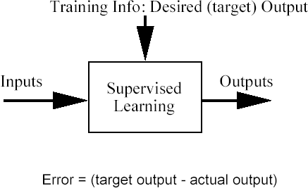
Classification problem
Training data: examples of the form (d,h(d))
where d are the data objects to classify (inputs)
and h(d) gives the class info for d, h(d)∈{1,…K}
Goal: given d_{new}, provide h(d_{new})

Slide 8
Bayesian Classifier

Slide 9
Bayesian Classifier
A statistical classifier
Performs probabilistic prediction, i.e., predicts class membership probabilities
Foundation
Based on Bayes’ Theorem.
Assumptions
The classes are mutually exclusive and exhaustive.
The attributes are independent given the class.
Called “Naïve” classifier because of these assumptions
Empirically proven to be useful.
Scales very well.
Fast and easy to implement

Slide 10
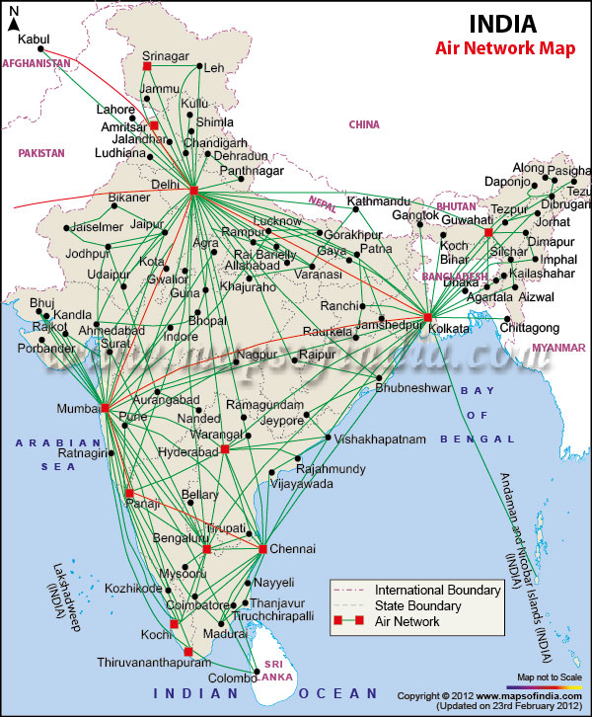
Example: Bayesian Classification
Example : Air Traffic Data
Let us consider a set observation recorded in a database
Regarding the arrival of airplanes in the routes from any airport to New Delhi under certain conditions.

Slide 11
Air-Traffic Data
Days | Season | Fog | Rain | Class
Weekday | Spring | None | None | On Time
Weekday | Winter | None | Slight | On Time
Weekday | Winter | None | None | On Time
Holiday | Winter | High | Slight | Late
Saturday | Summer | Normal | None | On Time
Weekday | Autumn | Normal | None | Very Late
Holiday | Summer | High | Slight | On Time
Sunday | Summer | Normal | None | On Time
Weekday | Winter | High | Heavy | Very Late
Weekday | Summer | None | Slight | On Time

Slide 12
Air-Traffic Data…
Days | Season | Fog | Rain | Class
Saturday | Spring | High | Heavy | Cancelled
Weekday | Summer | High | Slight | On Time
Weekday | Winter | Normal | None | Late
Weekday | Summer | High | None | On Time
Weekday | Winter | Normal | Heavy | Very Late
Saturday | Autumn | High | Slight | On Time
Weekday | Autumn | None | Heavy | On Time
Holiday | Spring | Normal | Slight | On Time
Weekday | Spring | Normal | None | On Time
Weekday | Spring | Normal | Heavy | On Time

Slide 13
Air-Traffic Data
In this database, there are four attributes
A = [ Day, Season, Fog, Rain]
with 20 tuples.
The categories of classes are:
C= [On Time, Late, Very Late, Cancelled]
Given this is the knowledge of data and classes, we are to find most likely classification for any other unseen instance, for example:
Classification technique eventually to map this tuple into an accurate class.
Week Day | Winter | High | None | ???

Slide 14
Bayesian Classifier
In many applications, the relationship between the attributes set and the class variable is non-deterministic.
In other words, a test cannot be classified to a class label with certainty.
In such a situation, the classification can be achieved probabilistically.
The Bayesian classifier is an approach for modelling probabilistic relationships between the attribute set and the class variable.
More precisely, Bayesian classifier use Bayes’ Theorem of Probability for classification.

Slide 15
Bayes’ Theorem of Probability

Slide 16
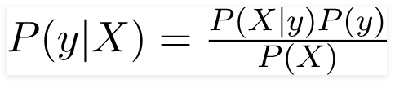
Naïve Bayes Theorem:
Bayes Theorem provides a way to calculates the
posterior probability P(y|X), from the prior probability P(y)
Using Bayes theorem, we can find the probability of y happening, given that X has occurred.
The assumption made here is that the predictors/features are independent. That is presence of one particular feature does not affect the other. Hence it is called naive.

Slide 17
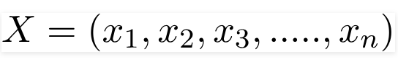
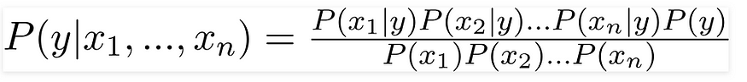
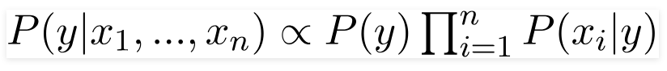
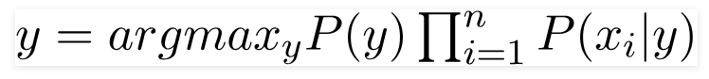
The variable y is the class variable(play golf/play tennis/……), which represents if it is suitable to play golf or not given the conditions. Variable X represent the parameters/features.
X is given as,

Slide 18
Example : Naïve Bayes
Outlook | Temperature Humidity W indy |  |  | Class
sunny | hot | high | false | N
sunny | hot | high | true | N
overcast | hot | high | false | Y
rain | mild | high | false | Y
rain | cool | normal | false | Y
rain | cool | normal | true | N
overcast | cool | normal | true | Y
sunny | mild | high | false | N
sunny | cool | normal | false | Y
rain | mild | normal | false | Y
sunny | mild | normal | true | Y
overcast | mild | high | true | Y
overcast | hot | normal | false | Y
rain | mild | high | true | N
Predict playing tennis in the day with the condition <sunny, cool, high, true>

Slide 19
Predict the class of the day with the condition <sunny, cool, high, true>
Let X= <sunny, cool, high, true>
We need to calculate P(Yes|X) and P(No|X)
For these, we use Bayes theorem
P(Yes|X) = P(Yes) * P(X|Yes) /P(X)
P(No|X) = P(No) * P(X|No) /P(X)

Slide 20
Play-tennis example: estimating P(x_{i}|y)
Outlook | Temperature Humidity W indy |  |  | Class
sunny | hot | high | false | N
sunny | hot | high | true | N
overcast | hot | high | false | Y
rain | mild | high | false | Y
rain | cool | normal | false | Y
rain | cool | normal | true | N
overcast | cool | normal | true | Y
sunny | mild | high | false | N
sunny | cool | normal | false | Y
rain | mild | normal | false | Y
sunny | mild | normal | true | Y
overcast | mild | high | true | Y
overcast | hot | normal | false | Y
rain | mild | high | true | N
P(y) = 9/14 P(n) = 5/14
outlook
P(sunny|y) = 2/9 | P(sunny|n) = 3/5
P(overcast|y) = 4/9 | P(overcast|n) = 0
P(rain|y) = 3/9 | P(rain|n) = 2/5
Temperature
P(hot|y) = 2/9 | P(hot|n) = 2/5
P(mild|y) = 4/9 | P(mild|n) = 2/5
P(cool|y) = 3/9 | P(cool|n) = 1/5
Humidity
P(high|y) = 3/9 | P(high|n) = 4/5
P(normal|y) = 6/9 | P(normal|n) = 1/5
Windy
P(true|y) = 3/9 | P(true|n) = 3/5
P(false|y) = 6/9 | P(false|n) = 2/5

Slide 21
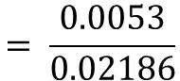
P(Yes| outlook=sunny, temp= cool, humidity=high wind=true) by using the given training data:
X= <sunny, cool, high, true>
p(outlook = sunny|yes) = 2/9
p(humidity = high|yes) = 3/9
p(temp = cool|yes) = 3/9
p(yes) = 9/14
p(wind = true|yes) = 3/9
P(X/y) * P(y) = $\text{9/14} \text{∗} \text{2/9} \text{∗} \text{3/9} \text{∗} \text{3/9∗} \text{3/9} \text{=} \text{0.0053}$
P(x) = P(outlook=sunny) * P(Temperature = cool) * P(humidity = high)*P(Wind = true)
= 5/14* 4/14*7/14*6/14 = 0.02186
$$= \frac{0.0053}{0.02186}$$
= 0.2424
P(Play= Y| x) =

Slide 22
Calculate P(No| outlook=sunny, temp= cool, humidity=high wind=strong)
using the given training data:
p(outlook = sunny|no) = 3/5
p(humidity = high|no) = 4/5
p(temp = cool|no) = 1/5
p(wind = true|no) = 3/5
p(No) = 5/14
P(X/y) * P(y) = $\text{5}\text{/14} \text{∗} \text{3}\text{/}\text{5} \text{∗} \text{1}\text{/}\text{5} \text{∗} \text{4}\text{/}\text{5}\text{∗} \text{3}\text{/}\text{5} \text{=}\text{ 0.0206}$
P(x) = P(outlook=sunny) * P(Temperature = cool) * P(humidity = high)*P(Wind = true)
= 5/14* 4/14*7/14*6/14 = 0.02186
P(Play =N|x) = 0.0206/0.02186 = 0.9421

Slide 23
P(Play= Y| x) = 0.2424
P(Play =N|x) = 0.9421
Since, P(Play =N|x) > (Play= Y| x) hence output is no.

Slide 24
Example -2 Air-Traffic Data
Days | Season | Fog | Rain | Class
Weekday | Spring | None | None | On Time
Weekday | Winter | None | Slight | On Time
Weekday | Winter | None | None | On Time
Holiday | Winter | High | Slight | Late
Saturday | Summer | Normal | None | On Time
Weekday | Autumn | Normal | None | Very Late
Holiday | Summer | High | Slight | On Time
Sunday | Summer | Normal | None | On Time
Weekday | Winter | High | Heavy | Very Late
Weekday | Summer | None | Slight | On Time

Slide 25
Air-Traffic Data…
Days | Season | Fog | Rain | Class
Saturday | Spring | High | Heavy | Cancelled
Weekday | Summer | High | Slight | On Time
Weekday | Winter | Normal | None | Late
Weekday | Summer | High | None | On Time
Weekday | Winter | Normal | Heavy | Very Late
Saturday | Autumn | High | Slight | On Time
Weekday | Autumn | None | Heavy | On Time
Holiday | Spring | Normal | Slight | On Time
Weekday | Spring | Normal | None | On Time
Weekday | Spring | Normal | Heavy | On Time
Week Day | Winter | High | Heavy | ???

Slide 26
Naïve Bayesian Classifier
With reference to the Air Traffic Dataset mentioned earlier, let us tabulate all the posterior and prior probabilities as shown below.
 |  | Class
Attribute |  | On Time | Late | Very Late | Cancelled
Day | Weekday | 9/14 = 0.64 | ½ = 0.5 | 3/3 = 1 | 0/1 = 0
 | Saturday | 2/14 = 0.14 | ½ = 0.5 | 0/3 = 0 | 1/1 = 1
 | Sunday | 1/14 = 0.07 | 0/2 = 0 | 0/3 = 0 | 0/1 = 0
 | Holiday | 2/14 = 0.14 | 0/2 = 0 | 0/3 = 0 | 0/1 = 0
Season | Spring | 4/14 = 0.29 | 0/2 = 0 | 0/3 = 0 | 0/1 = 0
 | Summer | 6/14 = 0.43 | 0/2 = 0 | 0/3 = 0 | 0/1 = 0
 | Autumn | 2/14 = 0.14 | 0/2 = 0 | 1/3= 0.33 | 0/1 = 0
 | Winter | 2/14 = 0.14 | 2/2 = 1 | 2/3 = 0.67 | 0/1 = 0

Slide 27
Naïve Bayesian Classifier
 |  | Class
Attribute |  | On Time | Late | Very Late | Cancelled
Fog | None | 5/14 = 0.36 | 0/2 = 0 | 0/3 = 0 | 0/1 = 0
 | High | 4/14 = 0.29 | 1/2 = 0.5 | 1/3 = 0.33 | 1/1 = 1
 | Normal | 5/14 = 0.36 | 1/2 = 0.5 | 2/3 = 0.67 | 0/1 = 0
Rain | None | 5/14 = 0.36 | 1/2 = 0.5 | 1/3 = 0.33 | 0/1 = 0
 | Slight | 8/14 = 0.57 | 0/2 = 0 | 0/3 = 0 | 0/1 = 0
 | Heavy | 1/14 = 0.07 | 1/2 = 0.5 | 2/3 = 0.67 | 1/1 = 1
Prior Probability |  | 14/20 = 0.70 | 2/20 = 0.10 | 3/20 = 0.15 | 1/20 = 0.05

Slide 28
Naïve Bayesian Classifier
Instance:
Case1: Class = On Time : 0.70 × 0.64 × 0.14 × 0.29 × 0.07 = 0.0013
Case2: Class = Late : 0.10 × 0.50 × 1.0 × 0.50 × 0.50 = 0.0125
Case3: Class = Very Late : 0.15 × 1.0 × 0.67 × 0.33 × 0.67 = 0.0222
Case4: Class = Cancelled : 0.05 × 0.0 × 0.0 × 1.0 × 1.0 = 0.0000
Case3 is the strongest; Hence correct classification is Very Late
Week Day | Winter | High | Heavy | ???

Slide 29
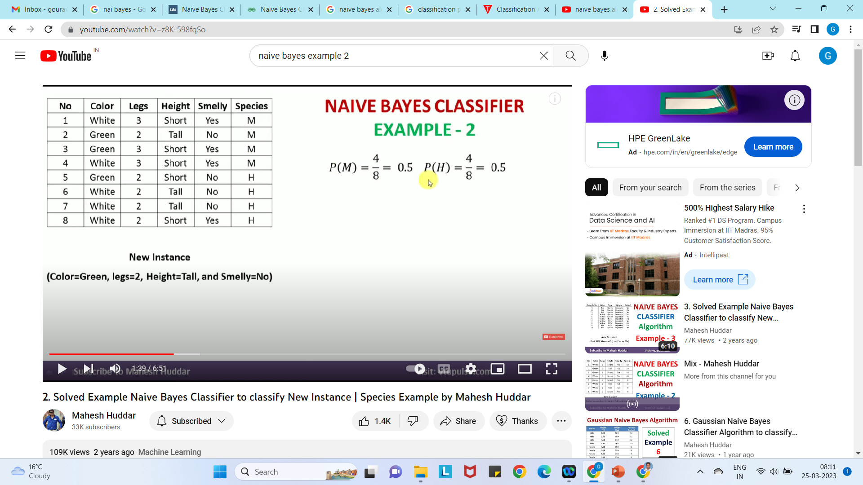
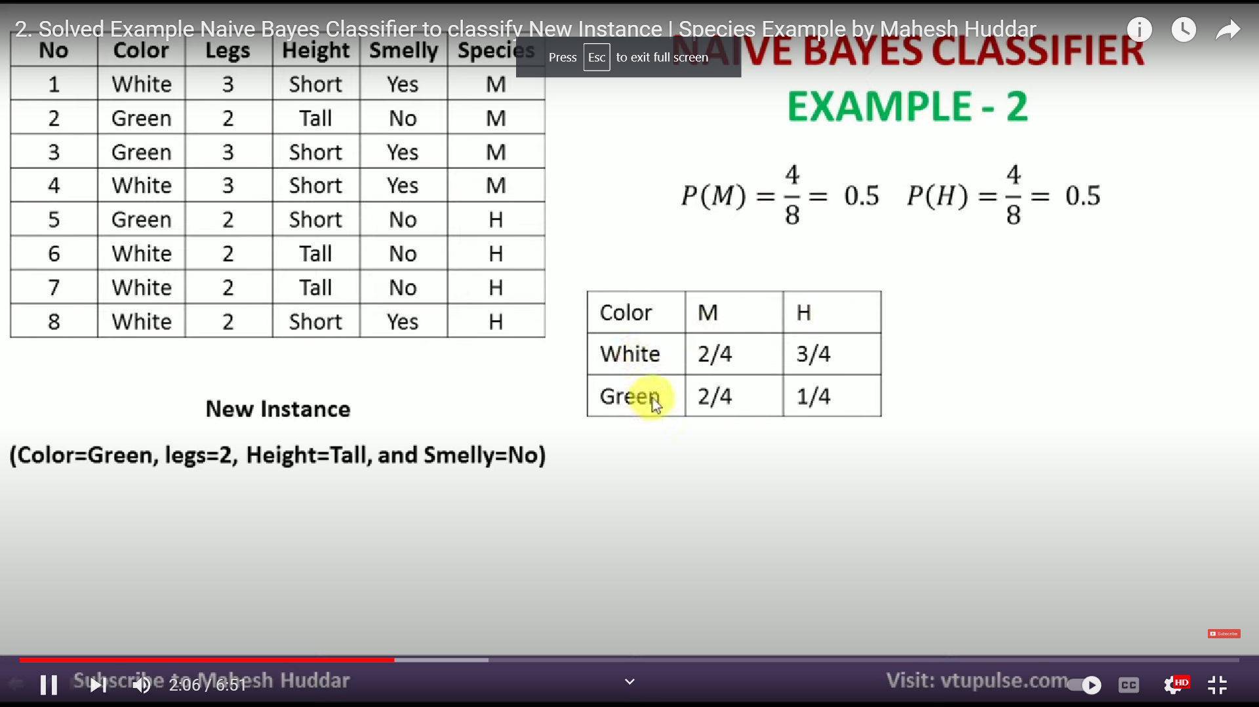
Example -3

Slide 30
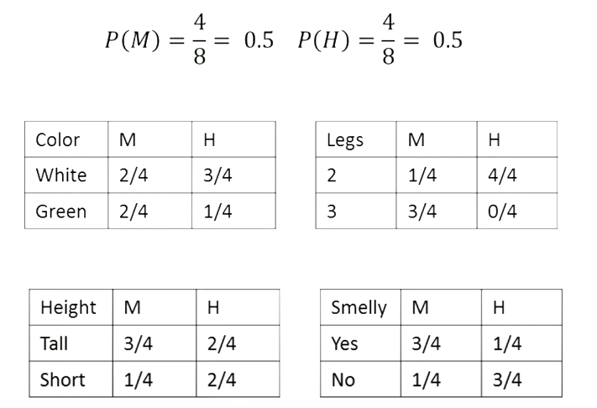

Slide 31
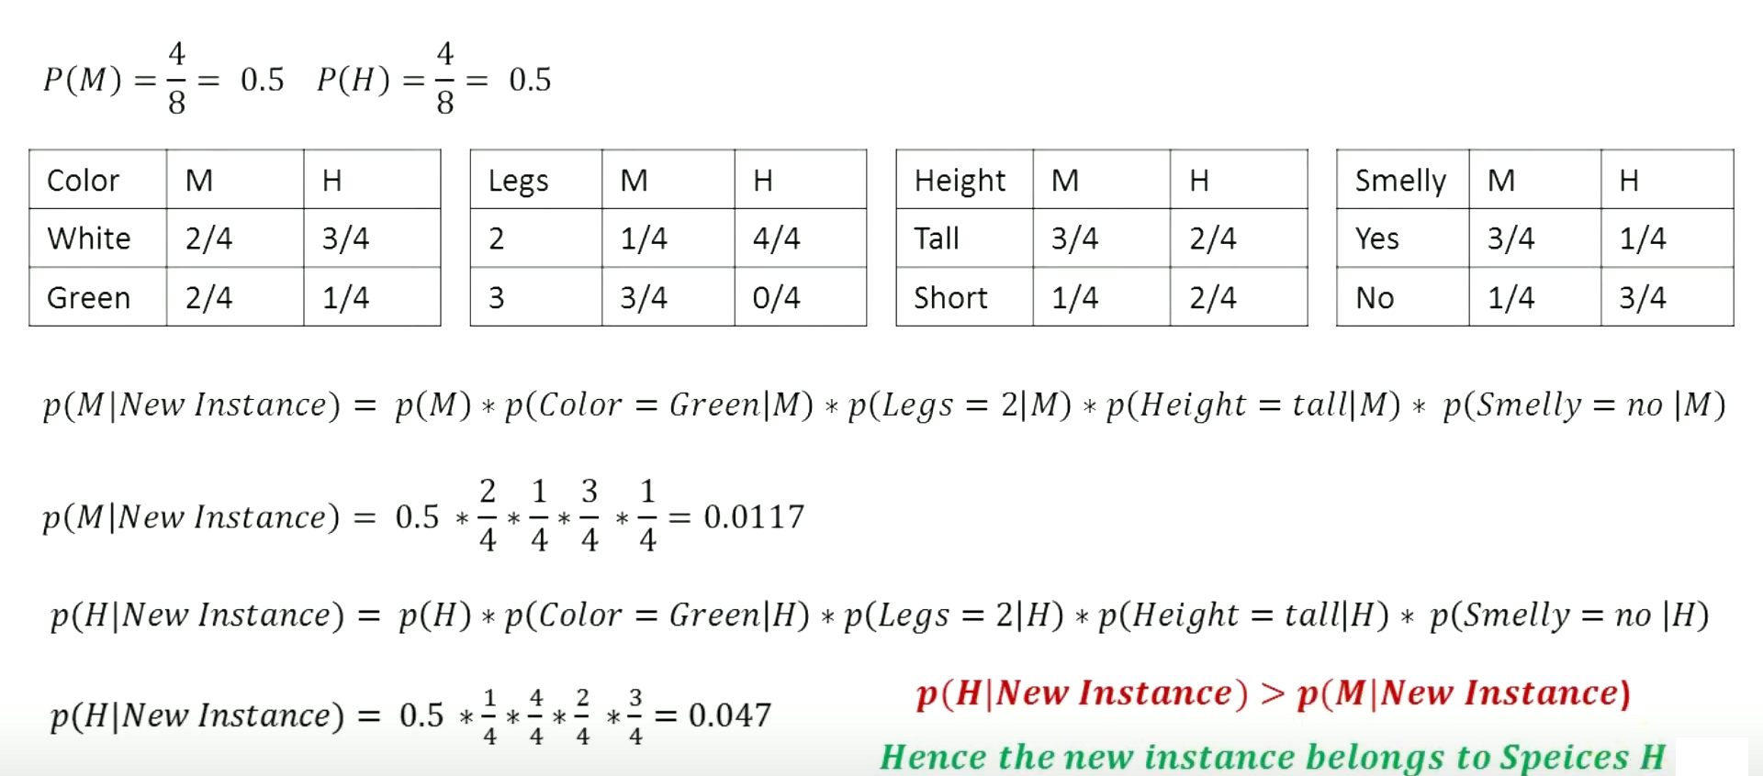

Slide 32
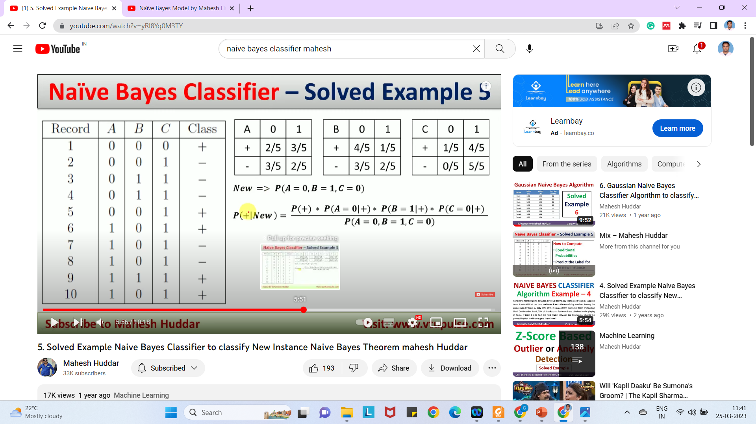
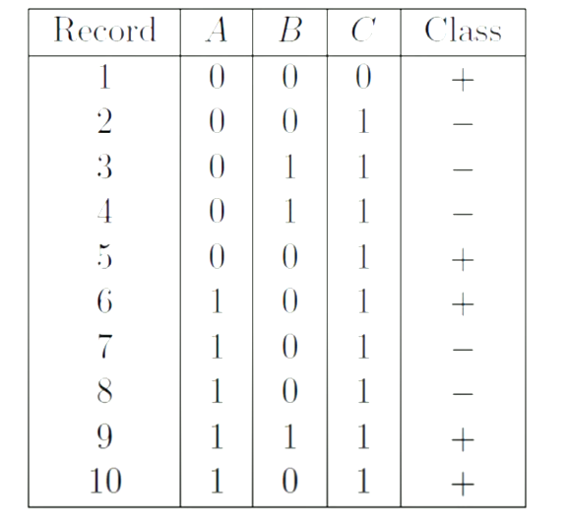

Slide 33
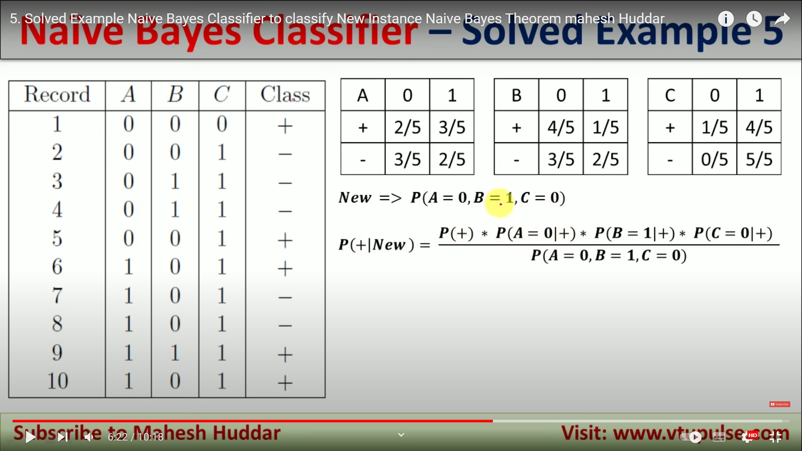
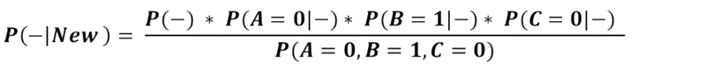
Last part is common, hence we can remove that

Slide 34
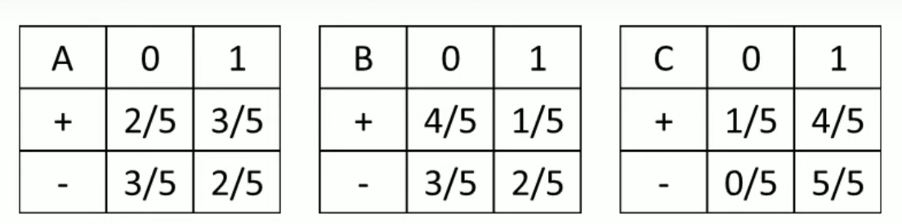
= 0.5 * (2/5 )* (1/5)*(1/5) = 0.008
= 0.5 * (3/5 )* (2/5)*(0/5) = 0.00
P(+|New) > P(-|New) Hence output is +.

Slide 35
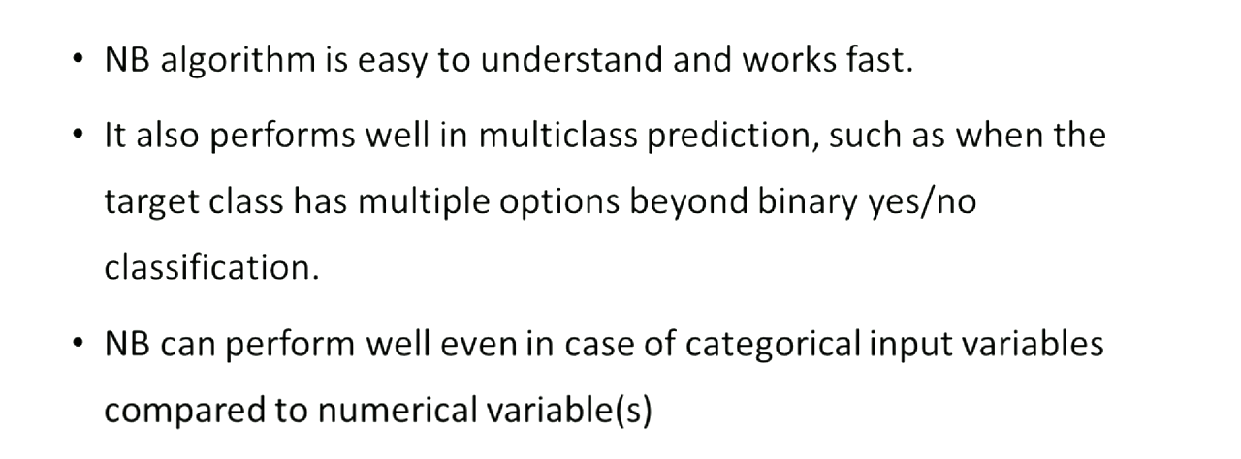
Advantages of NB

Slide 36
Cons:
If categorical variable has a category (in test data set), which was not observed in training data set, then model will assign a 0 (zero) probability and will be unable to make a prediction. This is often known as “Zero Frequency”. To solve this, we can use the smoothing technique. One of the simplest smoothing techniques is called Laplace estimation.
Another limitation of this algorithm is the assumption of independent predictors. In real life, it is almost impossible that we get a set of predictors which are completely independent.

Slide 37
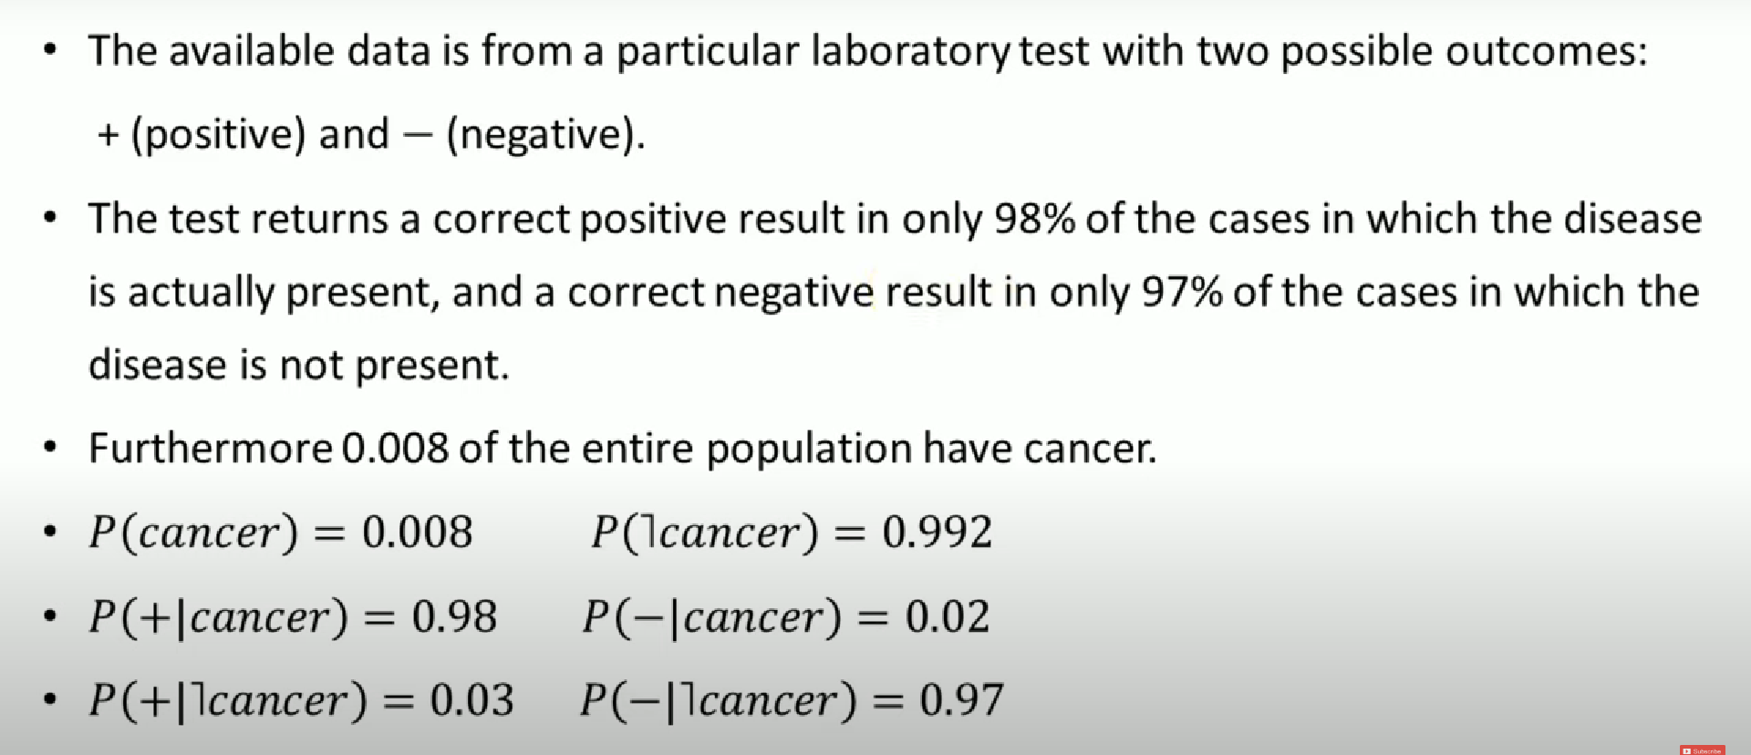
Does Patient have cancer or not ?

Slide 38
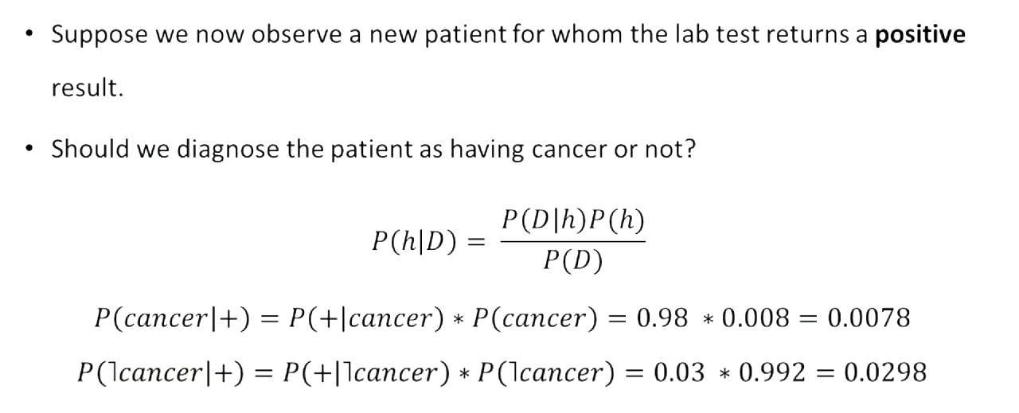

Slide 39
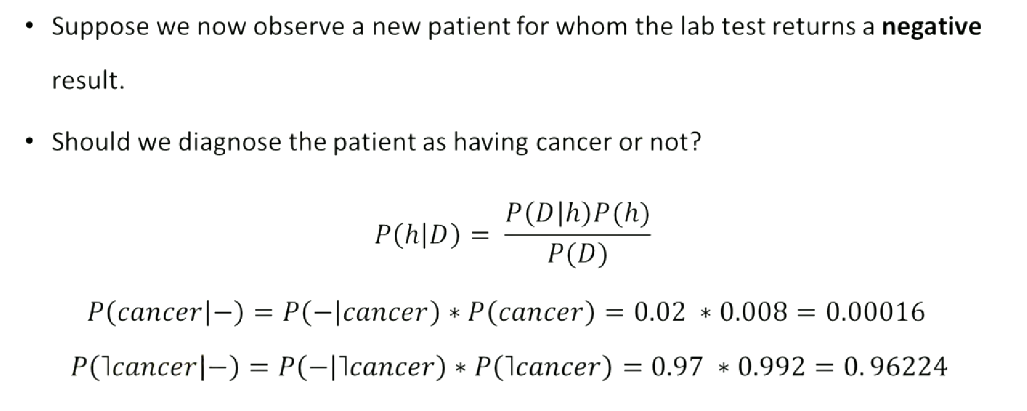

Slide 40
Thanks

